Slide 1
Discover Brands Before They Breakthrough

Slide 2

Welcome
Tim Michaels
Chief Executive Officer

Slide 3
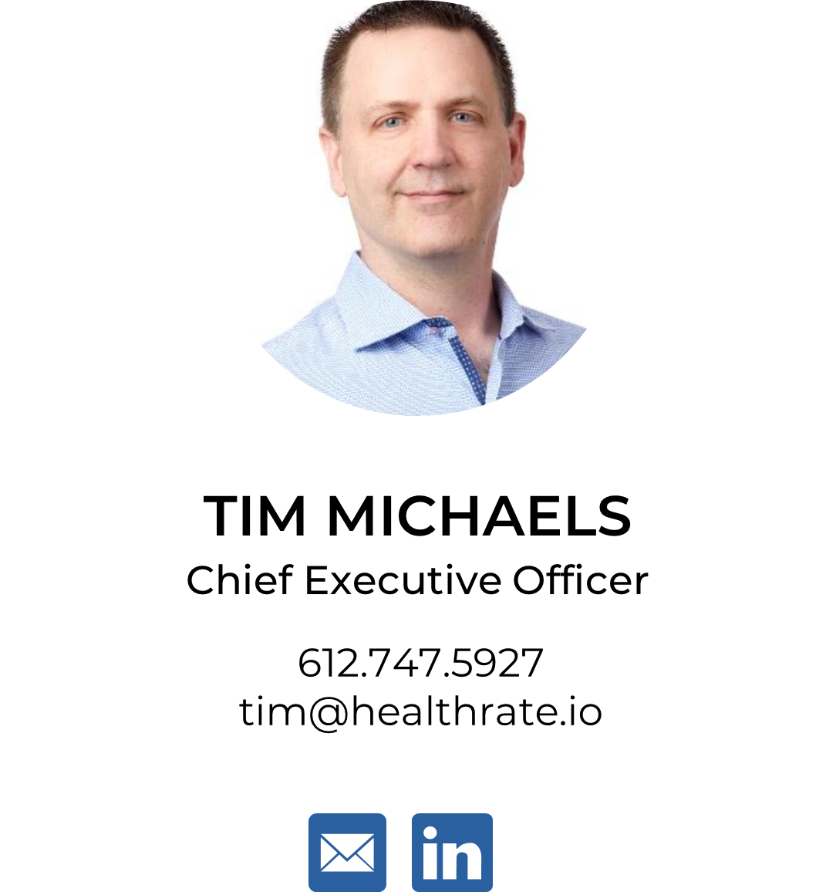
Tim Michaels
Chief Executive Officer
Tim is the Founder and CEO of HealthRate and has over 30 years of experience across healthcare with a focus on risk management, analytics, reimbursement strategies, and software development.
Prior to starting HealthRate, Tim successfully led the formation and operations of several public and private companies, worked as a strategic advisor to prominent healthcare organizations, and served on multiple governance boards. He has extensive experience in operations, product development, risk management, and information technology

Slide 4
“
HealthRate is like GoodRx for high-cost claims.
“
Paul Stordahl
Chief Actuary Emeritus, UnitedHealthcare

Slide 5
What is HealthRate?
PRICE ARBITRAGE
HealthRate is an Award-Winning SaaS platform that provides payers the best pricing for high-cost claims
No impact to quality
No provider abrasion
No patient intervention is required
No claims auditing or “chasing cash”
Implementation is as simple as adding click button analysis to your existing process
Notes:
Talking points – mention scope of high cost claims (oncology, CGT, OT, Stem?),
Scope of costs and savings = impacts about $25-30 of PMPM cost and can save 10-20% of that

Slide 6
Who Uses HealthRate & What Does it Cost?
Pricing is available on a monthly SaaS subscription model and is primarily based on the number of lives supported
You may also qualify for no risk pricing where HealthRate will guarantee savings and provide a 100% refund if agreed upon savings are not achieved.
FINANCIALY AT RISK ENTITIES AND FIDUCIARIES
Payers
At Risk Providers
Employers
Stop Loss Providers
Reinsurance
3RD Party Service Providers

Slide 7

How Does HealthRate Do It?
Specialty Contracting Expertise + Legislative Changes
Niche industry experts who have defined the industries payment methodologies, levers, and triggers for specialty reimbursement
Transparency in Coverage and No Surprises Act have triggered increased competition
Advanced Actuarial Expertise
Decades of real-world data
Proprietary Artificial Intelligence(AI) to ingest and process payment terms
Advance statistical analysis and proprietary algorithms to identify and quantify opportunities
PAYMENT OPTIMIZATION &
DECISION SUPPORT
Built on decades of domain experience, trillions of data points, advanced statistical methods, and recent advancements in AI/ML, HealthRate proactively identifies the optimal source and cost of care.
De-Mystified
Update your precertification and utilization processes with existing staff
Login to www.healthrate.io and begin saving!

Slide 8
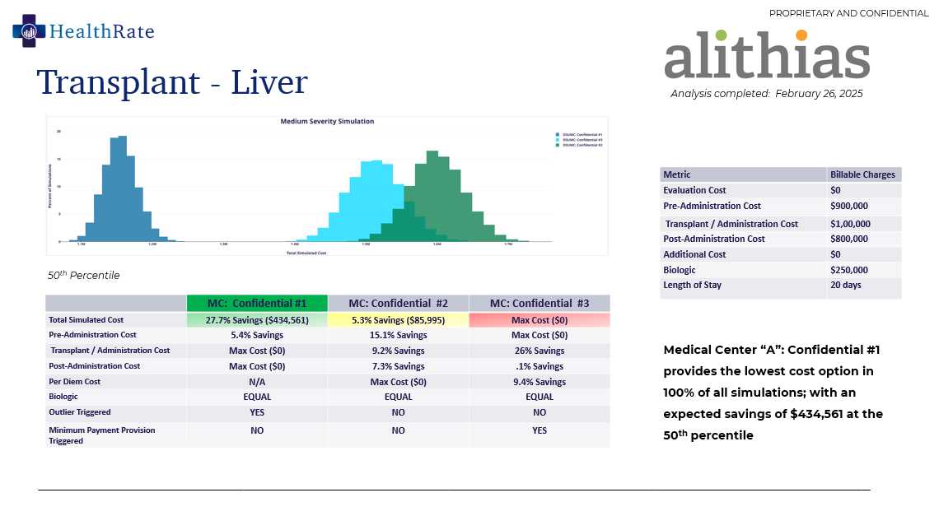
What Do I
Get?
DETAILED CASE ANALYSIS
A comprehensive analysis is produced for each case, clearly documenting the opportunity
COST CONTAINMENT
Each case can produce reduced claims between $50,000 and $1,000,000+.

Slide 9
How Do I Get Started?
Select your LOB’s and Service Lines
Commercial, Medicare, and Medicaid are all supported.
Oncology, Organ Transplants, Stem Cell Transplants, and Novel Therapies (CGT) are all supported
Select your Subscription Level
Self-service, full-service, and data only(API) models are supported
Your data, our data, or hybrid models are supported
SEEMLESS INTEGRATION
HealthRate requires minimal training, supports a zero-technology integration option, contains no HIPAA data and was designed with your existing processes in mind
Deploy
Update your precertification and Utilization Review process to complete a 1–3 minute price check
Login to www.healthrate.io and begin saving!

Slide 10
Thank You!

